Slide 1
Fury
Two Poems by David Morley
Poetry Unit S3

Slide 2
Context: Poetry
Learning Intentions
I am learning to
1. Demonstrate understanding by responding to different kinds of questions(ENG 4-17a)
2. Identify and comment on the theme or central concerns of a text (ENG 4-19a)
3. Identify and analyse the effect of aspects of language using some evidence and terminology (ENG 4-19a)
3. Explain and sum-up ideas, issues, and concepts when listening to complex spoken language (LIT 4-09a)
This Photo by Unknown Author is licensed under CC BY-SA

Slide 3
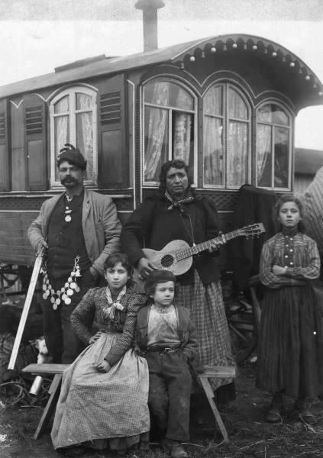
Starter
List as many connotations as you can think of for the following words:
Gypsy
Traveller
Extension
Look at the list you generated? Categorise the words into Positive Words and Negative Words.
This Photo by Unknown Author is licensed under CC BY-SA-NC

Slide 4
Cultural Assumptions (1)
Often, we have a particular viewpoint of certain marginalised groups in society. But how are our assumptions shaped?
Task
Watch this clip from BBC’s Peaky Blinders. Using 3 adjectives, describe the characters that you see.
https://www.youtube.com/watch?v=F-83mrw6SuY
Extension
What was your initial opinion of these characters and why?
This Photo by Unknown Author is licensed under CC BY-SA-NC

Slide 5
Cultural Assumptions (2)
Often, we have a particular viewpoint of certain marginalised groups in society. But how are our assumptions shaped?
Task
Now watch this clip from C4’s documentary called My Big Fat Gypsy Wedding.
https://www.youtube.com/watch?v=Ykk7_Qd79IU
What is your impression of the people represented in this show?
Do you think the documentary makers have been fair in their representation/treatment of this group?
This Photo by Unknown Author is licensed under CC BY-SA

Slide 6
The Collection Fury
The Poet
David Morley
In this collection we hear the voices of lots of different characters.
David Morley says: ‘The characters in my book FURY are voiceless but powerful: Gypsies, detainees, fighters. I love them and feel close to their characters, to people I know and have grown with […] I took them at their word without taking their words. These are their poems.’
Did you know?
In Greek Mythology The Furies were deities (gods) that sought vengeance? As we read these poems, think about how that idea might come into play.

Slide 7
Poem 1: ‘Fury’
Note
In the first poem in the set we hear the voice of a fairly well-known sportsman: Tyson Fury.
Have you ever heard of him?
The poet used an interview with Tyson Fury in The Guardian newspaper as the basis for creating Tyson Fury’s voice in this poem.
Task
Now read David McRae’s article called ‘Unbeaten Heavyweight Tyson Fury Reveals Dark Side to his Personality’.
This Photo by Unknown Author is licensed under CC BY-SA-NC

Slide 8
Now read the poem ‘Fury’
Think, Pair, Share
Who is the speaker?
What are they speaking about?
How does the speaker view their opponents?
Did anything surprise you about the poem?
You have 4 minutes!
This Photo by Unknown Author is licensed under CC BY

Slide 9
Collaborative Learning: Placemat Activity
Working collaboratively complete the placemat with the following pieces of information/evidence. Place info/ev at the four corners of the boxing ring.
x3 quotations that show over-confidence
X3 quotations about the speaker’s heritage/background
X3 quotations that show fragility in the speaker
Identification of x2 themes in the poem
In the middle
Deliver the knockout punch – select one quotation that sums up this speaker/poem entirely.

Slide 10
FURY

Slide 11
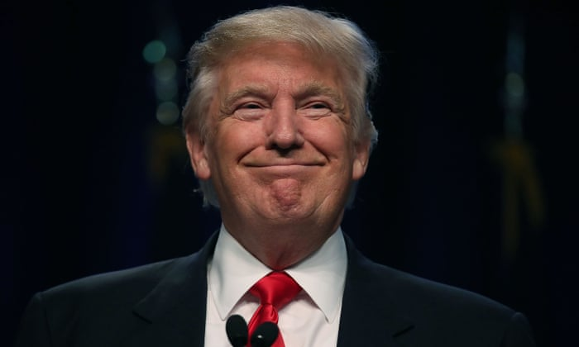
Tone - Braggadocio
The obvious tone used by the poet at the start of this poem is braggadocio. This tone is characterised by gloating and boastfulness.
Task
Watch this clip of Donald Trump speak. Quote two things he says that might be described as braggadocious.
https://edition.cnn.com/videos/politics/2017/10/10/times-trump-bragged-about-intelligence-orig-alee.cnn
Analysis Questions
Look at lines 1-10. How does the poet’s use of language (ie. techniques) create a braggadocious tone? (4 marks)
Why do you think this tone is used by the poet at this point in the poem? (2 marks)

Slide 12
Tone - Braggadocio
Braggadocio is created through the following techniques:
Hyperbole (exaggeration)
Word choice
Imagery
Repetition
Examples
‘I swagger to the exit’
‘I am fighting-royalty’
‘My corner-man and cut-man are mist and water, mist and slaughter’
‘A million beaten faces stare out’

Slide 13
Paired Activity: Verbal Grudge Match
This Photo by Unknown Author is licensed under CC BY
This Photo by Unknown Author is licensed under CC BY-NC-ND
One of you will be Joe Biden. The other, Donald Trump. You will have a verbal spar in which you both use a braggadocious tone to display your best qualities, but also to show your opponent’s biggest flaws and weaknesses.
Write it in the form of a script.
Draw straws as to who goes first
Take turns to make statements and responses!
I will judge who the winner is!

Slide 14
Contrast
Despite the swaggering, arrogant opening of the poem, we find a contrast occurring in lines 11-19.
Note: At this point the poet wants the reader to consider the theme of toxic masculinity. He uses Tyson Fury and his experience as a vehicle through which to explore this theme.
Task
Now watch these clips
1. https://www.independent.co.uk/life-style/toxic-masculinity-definition-what-boys-men-gillette-ad-behaviour-attitude-girls-women-a8729336.html
https://www.ted.com/talks/eldra_jackson_how_i_unlearned_dangerous_lessons_about_masculinity?language=en
What is your initial reaction to them? Discuss what you saw/heard with a partner.

Slide 15
Listening Assessment https://www.ted.com/talks/justin_baldoni_why_i_m_done_trying_to_be_man_enough/transcript
1. Explain in your own words what this clip is about. (2 marks)
3. How does the writer create humour in this clip? You should make reference to two techniques that he uses (ie. Word choice, imagery, structure etc.). (4 marks)
4. Listen from 1.00 to 1.30. Summarise in your own words two main points forwarded by the speaker here. (2 marks)
5. Listen from ‘I’ve been pretending’ to ‘now right?’. The writer uses a series of balanced phrases to get his point across. Quote one of the balanced phrases. (1 mark)
Listen from 2.09-2:57. Summarise three things boys are taught, according to the speaker. (3 marks)
Summarise what the speaker felt was wrong with the things his dada taught him.
(2 marks)
Listen from 6.28. Quote one piece of imagery used by the speaker and explain why it is a good image to use at this point in his argument. (3 marks)
The speaker tells us that there was something he wanted to speak to his guy friends about. Quote one piece of word choice used by the speaker to show his anxiety about doing this and explain how your chosen word proves he was anxious. (2 marks)
7. What is the purpose of this clip? (1 mark)

Slide 16
Analysing Tone in ‘Fury’
Analysis Questions
Explain how the writer’s use of language conveys a more fragile speaking voice in lines 11-17. (4 marks)
Why do you think this fragile voice only lasts for a few lines, before changing back to braggadocious again? (2 marks)
Complete answers in your OneNote jotter.

Slide 17
Imagery
In line 30 the persona asserts:
‘I am Master of It all.’
How is this image developed in the next 11 lines? Write a detailed critical essay paragraph.
[Remember: TS, C, Q, A, E]

Slide 18
Sonic Techniques: Assonance and Alliteration
Important Note
Assonance is the repetition of vowel sounds (a,e,I,o,u)
Alliteration is the repetition of first letters (usually consonants)
Tasks
Complete table with examples from poem.
Explain in two sentences what these sonic techniques draw our attention to.
Assonance | Alliteration
1. “________________” | 1.
2. | 2.
3. | 3.

Slide 19
Sentence Structure
Task One
Find one example of each of these techniques in the poem. You can work with a partner to divide the workload if you like.
Task Two
Can you explain how each of these techniques work in the given context of the poem?
Sentence structure is the way that a sentence/paragraph is put together. A writer has a number of sentence structure techniques that can they draw on such as:
Repetition
Minor sentence
List
Rhetorical questions/questions and answers
Parenthesis

Slide 20
Turning Point
Note
Up until this point in the poem we have heard the voice of THE CHARACTER Tyson Fury, ie. the persona that he takes on in public of a swaggering, arrogant boxer. The turning point arrives with the statement: ‘I’ll tell you who Fury is.’
Task
What do we learn about him in the final part of the poem? Who is Tyson Fury? List four things.
This Photo by Unknown Author is licensed under CC BY-SA

Slide 21
Evaluating the Poem
In what way does this poem deal effectively with mental health issues?
In what way does this poem effectively present the voice of people living on the margins of society?
What do you think the poet’s wider message is about Tyson Fury and the community in which he lives?
What did you find most interesting about this poem and why?
I used to think______________ about masculinity. Now I think _________________________________.

