Slide 1
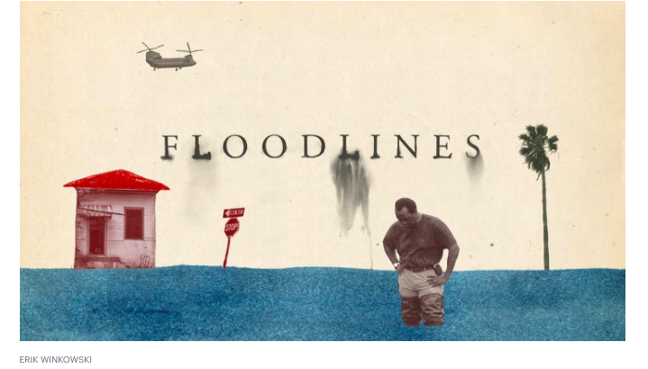
Analysing Podcasts ‘Floodlines’, by The Atlantic
This Photo by Unknown Author is licensed under CC BY-SA

Slide 2
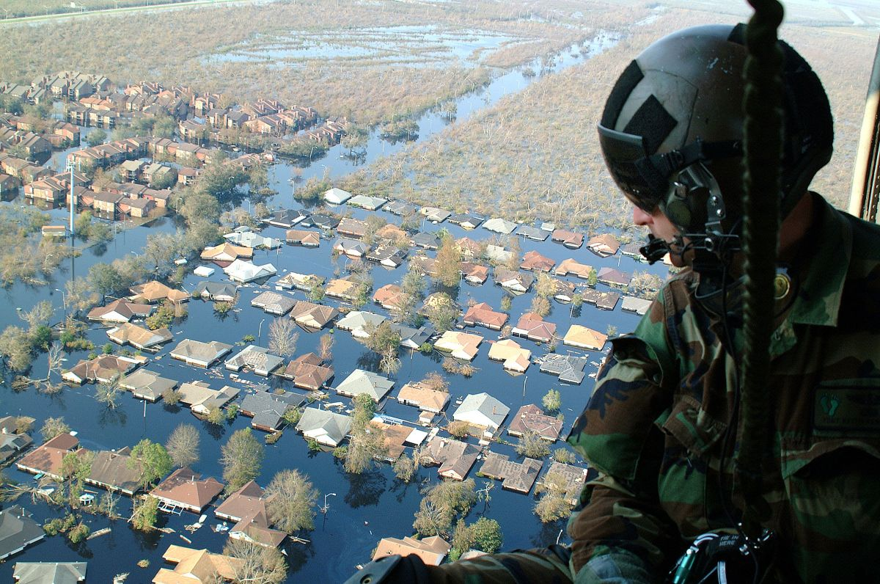
Context: Spoken Language
Learning Intentions
I am learning to
1. Make notes and organise them to develop thinking (LIT 3-05a/4-05a)
2. Explore issues and create new texts using my own words as far as possible (LIT 3-05a/4-05a)
3. Communicate detailed or complex ideas when talking to others (LIT 4-09a)
Starter
Write three sentences explaining what you think is happening in the image below.
This Photo by Unknown Author is licensed under CC BY-NC

Slide 3
Hurricane Katrina, August 2005
Winds reach 39 MPH, becomes tropical storm
Watch this video from the National Geographic:
https://www.youtube.com/watch?v=HbJaMWw4-2Q
Complete the cycle diagram, explaining what happened during the hurricane.

Slide 4
Background to ‘Floodlines’
The Atlantic
Look for truth and integrity in a story
great storytelling
great journalism
honest reporting and analysis
The Podcast
Host, Vann R. Newkirk II, sets out to re-examine what happened during Hurricane Katrina, 15 years ago.
The story of a natural disaster
But: story of human negligence and error

Slide 5
Context: New Orleans
Pre-listening Activity
Working with a partner, do a Google search for New Orleans. Find out one fact about:
a.) its location
b.) the geography of the place
c.) the population of the city
This Photo by Unknown Author is licensed under CC BY-SA

Slide 6
Facts about New Orleans
Major port city
2020 population of 390,128: 58% are black or African American
The city is named after the Duke of Orleans, who ruled as regent for the French King Louis XV, from 1715-1723
French and Spanish colonized and influenced the culture of the place
New Orleans famous for cuisine, jazz and Mardi Gras festival
The city of New Orleans straddles the Mississippi River
Famous locations in NOLA are: the French Quarter (including Bourbon Street) and Lake Pontchartrain
This Photo by Unknown Author is licensed under CC BY-SA

Slide 7
Episode One ‘Antidiluvian’
This Photo by Unknown Author is licensed under CC BY-SA

Slide 8
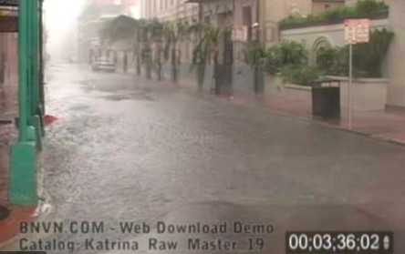
Context: Spoken Language
Starter
This image was taken from footage captured by a “storm chaser” during the early stages of Hurricane Katrina.
Write two paragraphs, in their voice, describing the unfolding scene as you drive through the eerily deserted streets of New Orleans’ French Quarter.

Slide 9
Episode One
Listen to Episode One.
As you listen, complete the Analysing Podcasts worksheet. Remember to take notes on any aspect of this podcast you find interesting.
You might need to listen to a particular section twice or consult the episode transcript (available on the ‘Floodlines’ website) for further clarification of a point.

Slide 10
Post-listening Activities
This episode is called ‘Antidiluvian’. Find the meaning of this word and then explain how this title links to the topic of the episode.
In your opinion, was this podcast episode balanced? Give reasons to support your answer.
Consider the podcast episode as a whole. Do you think the episode was fair in its representation of the people affected by the flood? Again, give reasons for your answer.
What was the biggest surprise in this episode for you? Explain why you found it surprising.

Slide 11
Plenary This image comes from Beyonce’s ‘Formation’ video. What point do you think the artist is trying to make here? Discuss with a partner. Be prepared to share your thoughts in a whole class discussion.

