Slide 1
Memoir
National 5 Writing

Slide 2
Context: Broadly Creative Folio
Learning Intentions
I am learning to
1. engage readers through my use of language, style and tone as appropriate to genre
2. create a convincing impression of my personal experience and reflect on my responses to events/experiences
3. proof-read and self-edit as an integral part of the writing process
Starter
List three experiences in your life that you feel were memorable but for quite different reasons.
ie.

Slide 3
Broadly Creative (Folio 2)
1,000 words
Task
Write one chapter of a memoir. This chapter should be based on a period of your life you found particularly enjoyable/difficult/interesting.
In your essay you should explain what the period was, and why it was enjoyable. You should then comment on what was lost/gained during this period.
This Photo by Unknown Author is licensed under CC BY-SA

Slide 4
Being Creative
The point of this essay is to reflect on things that have actually happened to you, in order that you can reflect upon what you have learned about yourself from them.
The “creative” part comes from the way you tell the story.
This Photo by Unknown Author is licensed under CC BY-SA-NC

Slide 5
What is Memoir?
The clue is in the title.
An account of one’s personal life and experiences.
It is not an AUTOBIOGRAPHY of a WHOLE LIFE; it can be more creative than factual as it is merely an account of experiences.
Me
Moi
I

Slide 6
MS Forms
Watch this episode of The Big Scottish Book Club, hosted by writer Damian Barr. In this episode the host talks to comedian Janey Godley and writer Lemn Sissay about their memoirs.
The Listening questions on MS Forms will allow you to think more about the genre.
This Photo by Unknown Author is licensed under CC BY

Slide 7
The Personal Bit
There are three of these areas that you could focus on, as someone in S4. Settle on one for your memoir.
Task
During that period of your life, what is the best memory you have and why?
During that period of your life, what is the worst memory you have and why?
Early life
Childhood (Primary)
Teenage Years (Secondary)
Late Teens/Twenties (Uni/Work)
Thirties (Parenthood)
I could say lots about each of these areas. But which one could I write a bit more creatively on than others? That is the trick – settling on material.

Slide 8
Why Focus on Early Childhood?
ROALD DAHL, Boy: Tales of Childhood
An autobiography is a book a person writes about his own life and it is usually full of all sorts of boring details.
This is not an autobiography. I would never write a history of myself. On the other hand, throughout my young days at school and just afterwards a number of things happened to me that I have never forgotten.
None of these things is important, but each of them made such a tremendous impression on me that I have never been able to get them out of my mind. Each of them, even after a lapse of fifty and sometimes sixty years, has remained seared on my memory.
I didn’t have to search for any of them. All I had to do was skim them off the top of my consciousness and write them down.
Some are funny. Some are painful. Some are unpleasant. I suppose that is why I have always remembered them so vividly. All are true.
This Photo by Unknown Author is licensed under CC BY-SA-NC

Slide 9
Pointer One
Whittle it down to the right memories
Don’t be too ambitious
Narrow it down to a year in your life
Focus on the two or three most important memories you have form that year
Be able to say why these episodes/memories are important

Slide 10
Pointer Two
Use the same literary devices novelists use to write their fiction
Metaphor/Extended Metaphor
Symbolism
Characterisation
Theme
Theme
Education
Poverty
Loneliness
Responsibility

Slide 11
Pointer Three
Match the voice with the point of view
If you are writing from the point of view of a child, you have to make the voice realistically child-like
If you are writing from the point of view of being a teenager, you should make the voice recognisably teenage.
Task
Change the blue sentence into a more “teenage” P.O.V.
I walked down the street with my mum.
Now try again, making the voice seem more child-like in it’s P.O.V.

Slide 12
Pointer Four
Dramatise yourself as Narrator
You are the ultimate storyteller in your life story. Your voice in this memoir should sound important.

Slide 13
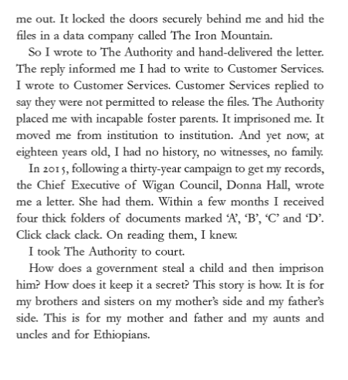
Preface, My Name is Why, Lemn Sissay

Slide 14
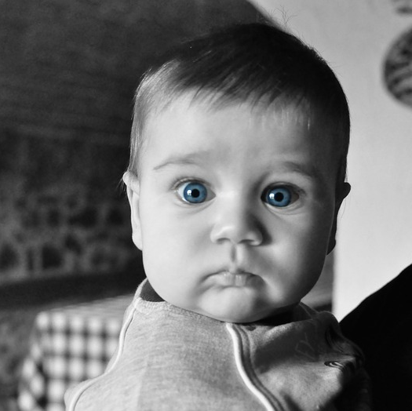
Pointer Five
Surprise your reader
Start at the middle or end of your story
Dislocate/challenge the reader – make them work for the story
Use humour for serious topics and vice versa

Slide 15
Pointer Six
Pace your story
Don’t give the game away at the start
Drip-feed your audience the important facts
Make sure you are working at a steady pace towards an interesting conclusion
This Photo by Unknown Author is licensed under CC BY-SA

Slide 16
Now Write

Slide 17
Marking Criteria National 5

Slide 18
Context
Success Criteria
1. Experiences detailed with level of insight and involvement
2. Reflections on experience(s)
3. Features of genre utilised
Structure that supports and enhances meaning
Attention to purpose/audience consistent throughout
Tools for Writing
Before submitting your first draft check:
Spelling
Grammar (including tenses, singulars/plurals, sentence structure etc.)
Linkage of ideas
Paragraphing

