Slide 1
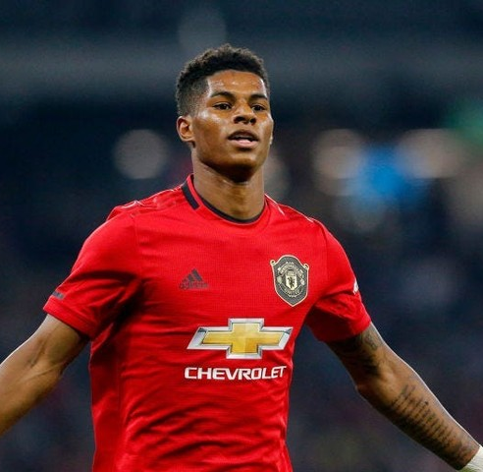
Writing Poetry
BGE Creative Writing
Level Three and Four
This Photo by Unknown Author is licensed under CC BY

Slide 3
Context: Creative Writing
Learning Intentions
I am learning to
use the conventions of a chosen genre successfully
create an appropriate mood or atmosphere
create convincing speaking voice ENG 4-31
Task
Taking inspiration from a celebrity interview, work collaboratively to write a 20-line poem.
Success Criteria
First person narration
Lines from the interview woven through
Emotive language used to convey the personality of speaker

Slide 4
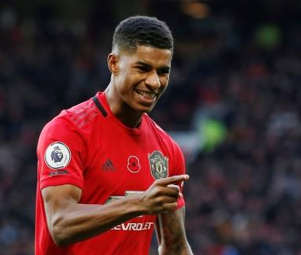
The Article
Task One
Read through the Nov 2020 GQ Magazine interview with Marcus Rashford.
Task Two
What is this article about?
What impression do we get of Marcus Rashford from this article?
Does Rashford say anything that interests or surprises you? If so, what and why?
In this interview people’s reactions to Rashford are described. Find three words that describe others’ reactions to the footballer and explain what each word reveals about the player.
This Photo by Unknown Author is licensed under CC BY-NC

Slide 5
Thinking About Theme
Re-read this article. What are the big issues that the writer of the interview foregrounds?
Discuss with a partner. Mind-map your ideas.
Issues
1.
2.
3.
4.

Slide 6
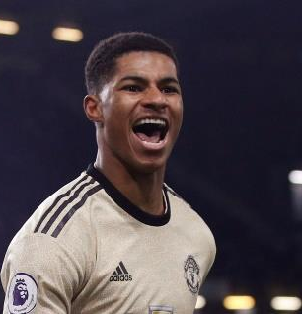
The Article
Task
Read through the article. Identify 15 great words or phrases that best sum-up the voice/spirit/character of Marcus Rashford.
Ie. ‘extremely admirable’
Then
Cut out these phrases. Stick them to your paper. Leave space around the word/phrase to write your thoughts/reflections/ideas about it.
This Photo by Unknown Author is licensed under CC BY-NC

Slide 7
Working into the text
‘The first thing I notice about Marcus Rashford is not the man himself, but his energy’
Task
How do you turn this quotation from the article into poetry? Work with a partner to transform these lines into the voice of Marcus Rashford. You have four minutes.

Slide 8
Working into the text
‘He’s a combination of grace, humility, modesty’
My mum cooked up bowlfuls
of humility,
Served us plates of
grace and modesty.

Slide 9
Extending the Metaphor
My recipe for success?
Humility, a sprinkling of modesty
and a bag of hardwork.
It's actually been quite a
fun meal to make.

Slide 10
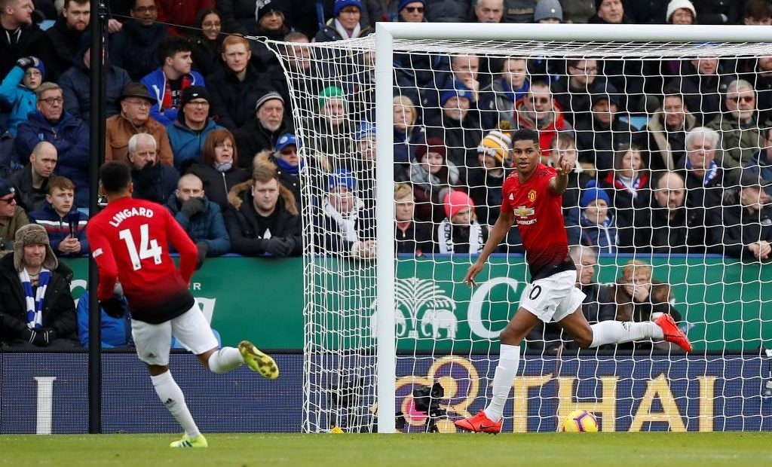
Planning
Your poems should
Explore a theme/idea (ie. Rashford’s charitable nature or the theme of activism)
Convey his voice (written from his point of view)
Use phrases from the article
Imagery, word choice, alliteration, assonance used to good effect
This Photo by Unknown Author is licensed under CC BY-NC

